Slide 1
MMA 867 Predictive Analytics Principal Components Analysis

Slide 2
Agenda
Module 1: What is PCA?
Group Discussion #1
Module 2: Use PCA in regression
Advanced topics: How PCA works (optional)

Slide 3
Module 1: What is PCA?

Slide 4
Principal Component Analysis: Introduction
Principal Component Analysis (PCA) is a dimension-reduction or data compression method.
It is useful when you have obtained data on a large number of correlated variables, and believe that there is some redundancy in them (possibly because they are measuring the same construct).
This redundancy makes you believe that it should be possible to reduce the observed variables into a smaller number of principal components (linear combinations of the original variables) that will account for most of the information in the observed variables.

Slide 5
PCA and Face Recognition

Slide 6
Motivating Example: Job Satisfaction Questionnaire
To predict the “intention to quit”, you have developed a 7-item measure of job satisfaction. The questionnaire is reproduced below
You intended to use the employees’ responses to the 7 questions as seven separate predictors in a multiple regression model.

Slide 7
Motivating Example: Job Satisfaction Questionnaire
You administer the questionnaire to 200 employees and collect their responses in the following table:
Employee | Q1 | Q2 | Q3 | Q4 | Q5 | Q6 | Q7
1 | 4 | 2 | 4 | 5 | 1 | 3 | 2
2 | 5 | 6 | 6 | 7 | 5 | 6 | 7
3 | 2 | 2 | 3 | 1 | 5 | 7 | 7
4 | 2 | 3 | 5 | 1 | 3 | 2 | 3
….
200 | 4 | 3 | 5 | 3 | 6 | 5 | 7

Slide 8
Motivating Example: Job Satisfaction Questionnaire
Redundancy leads to multi-colinearity problems in multiple regression
Too many coefficients to estimate…
Notice that items 1- 4 all deal with the same topic: the employees’ satisfaction with their supervisors (they are somewhat redundant to one another)
Similarly, items 5-7 all concern the employees’ satisfaction with their pay.

Slide 9
What can PCA do?
Because of redundancy, it would be advantageous to reduce the number of variables. PCA will do the following for us:
Variable 1-4 are compressed into a single component that reflects satisfaction with supervision
Variable 5-7 are compressed into a single component that reflects satisfaction with pay
You could then use these two new components (instead of seven original variables) as predictors in multiple regression.
7 correlated variables
Q1
Q2
Q3
Q4
Q5
Q6
Q7
C1
C2
satisfaction with supervision
satisfaction with pay
2 uncorrelated components

Slide 10
What is a principal component?
Component is a weighted sum (linear combination) of the original variables.
Q1
Q2
Q3
Q4
Q5
Q6
Q7
.40
.47
.32
.02
.01
Weights
.44
.03
C1
Component 1:satisfaction with supervision
Score
C1 =.44(Q1)+.40(Q2)+.47(Q3)+.32(Q4) +.02(Q5)+.01(Q6)+.03(Q7)
Questions 1– 4 were assigned large weights
because these questions assess supervision
Questions 5 –7: very small weights
since they assess pay

Slide 11
What is a principal component?
Obviously, a different equation, with different weights, would be used to compute subject scores on component 2
Q1
Q2
Q3
Q4
Q5
Q6
Q7
.01
.03
.01
.42
.45
Weights
.02
.50
C2
Component 2:satisfaction with pay
Score
C2 =.02(Q1)+.01(Q2)+.03(Q3)+.01(Q4) +.42(Q5)+.45(Q6)+.50(Q7)
Questions 1– 4: small weights because they assess supervision
Questions 5 –7: large weights
since they assess pay

Slide 12
What is a principal component?
In reality, the number of components extracted in PCA is equal to the number of original variables (7 in our example).
For each employee, we can calculate a score on a given principal component (so each person has 7 scores, score of supervision, pay, …)
In most cases, only the first few components account for meaningful amounts of variance, so only these first few components are retained.
You would assume that the remaining 5 components accounted for only trivial amounts of variance.
Score
Score of component i
C_{i} = w_{1i}(Q₁) + w_{2i}(Q₂) + w_{3i}(Q₃) + w_{4i}(Q₄)+ w_{5i}(Q₅) + w_{6i}(Q₆) + w_{7i}(Q₇)
Weights
i =1,…,7

Slide 13
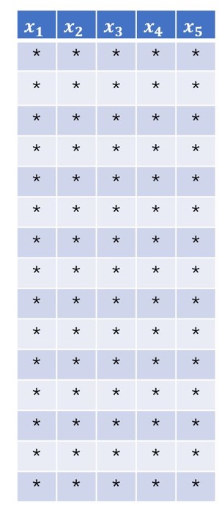
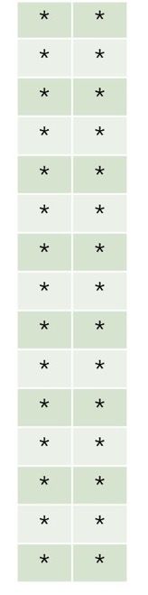
Dimension Reduction
Raw data
Scores
Weights
w_{11,} w₂₁, w₃₁ , w₄₁, w₅₁

Slide 14
Dimension Reduction
Raw data
Scores
Weights
w_{12,} w₂₂, w₃₂ , w₄₂, w₅₂

Slide 15
Characteristics of Principal Components
The first component accounts for a maximal amount of total variance in the original variables
The second component extracted will have two important characteristics:
It will account for a maximal amount of variance in the data set that was not accounted for by the first component.
It will be uncorrelated with the first component
The remaining components display the same two characteristics:
Each component accounts for a maximal amount of variance that was not accounted for by the preceding components.
It is uncorrelated with all of the preceding components

Slide 16
Group Discussion #3

Slide 17
Module 2: How to use PCA in regression (with R example)

Slide 18
Principal Components Regression (PCR)
13 correlated predictors
V1
V2
V3
V4
…..
V11
V12
V13
PCA
C1
…..
C_k
Linear
regression
Response

Slide 19
Advanced topics (Optional)

Slide 20
Geometry of Principle Components (Two-variable Example)
Height
Weight

Slide 21
PCA is like fitting an ellipsoid to the data
Height
Weight
Each axis of the ellipsoid represents a principal component.

Slide 22
PCA: Projection on the principle components
Height
Score of component 1
Score of component 2
Weight

Slide 23
Geometry of Principle Components
Score of component 1
If some axis of the ellipsoid is small, then the variance along that axis is also small,
By omitting that axis (principal component), we lose only a small amount of information.

Slide 24
Geometry of Principle Components

Slide 25
Geometry of Principle Components

Slide 26
A Brief Summary
PCA transforms a number of correlated variables into a smaller number of uncorrelated principal components.
The principal components are linear combinations (like a weighted average) of the original variables.
The first principal component accounts for as much of the variability in the data as possible, and each succeeding component accounts for as much of the remaining variability as possible.
In a geometric view, it is like fitting an ellipsoid to the data.
Projection on the long axis preserves most variance in the data.
How does PCA compute the weights of each component and the amount of variance it captures?

Slide 27
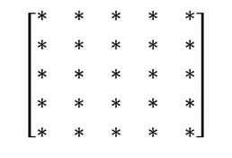
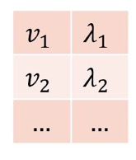
Eigenvalues and eigenvectors
PCA is performed on the covariance matrix of the data.
Raw data
Scores
Eigenvectors
Covariance matrix
Eigenvalues

Slide 28


Eigenvectors of Covariance Matrix
The covariance matrix $S$ gives us information about variance and covariance among all variables
Eigenvectors of $S$
Height
Eigenvectors are at right angles (orthogonal), and each is an axis of the ellipsoid fitted to the data.
Weight

Slide 29
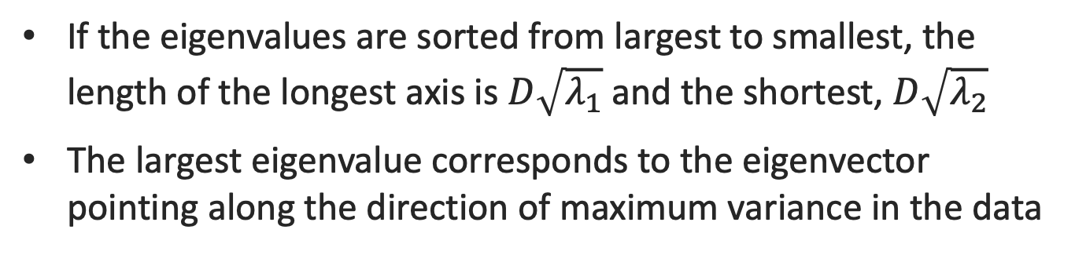
Eigenvalues of Covariance Matrix
Confidence region ellipse
If the eigenvalues are sorted from largest to smallest, the length of the longest axis is $D\sqrt{λ_{1}}$ and the shortest, $D\sqrt{λ_{2}}$
The largest eigenvalue corresponds to the eigenvector pointing along the direction of maximum variance in the data

Slide 30
Eigenvalues, Eigenvectors and Covariance Matrices
We calculate eigenvalues of the covariance matrix and sort them from largest to smallest
Sorted eigenvalues give us successive directions of diminishing variation
Eigenvectors corresponding to the largest eigenvalues give directions of maximum variation in the data
Eigenvectors corresponding to the second largest eigenvalues give directions of second largest variation
and so on…

Slide 31
PCA and Face Recognition
Eigenfaces
A set of eigenfaces can be generated by performing PCA on a large set of images depicting different human faces.
Eigenfaces can be considered a set of "standardized face ingredients” (symmetry, style of facial hair, hairline, size of the nose or mouth, etc.), derived from many pictures of faces.
Any human face can be considered to be a combination of these standard faces

Slide 32
PCA and Face Recognition
Remarkably, it does not take many eigenfaces combined together to achieve a fair approximation of most faces.
A person's face is not recorded by a digital photograph, but instead as just a list of PCA scores, much less storage space is required.
This technique is also used for handwriting recognition, lip reading, voice recognition, sign language, hand gestures interpretation and medical imaging analysis.

Slide 33
Partial least squares: Supervised Learning
PCA finds the directions that best explain the predictors X.
There is no guarantee that the principal directions will also be the best directions to use for predicting the response Y.
Principal components are identified in an unsupervised way: the response Y does not supervise the identification of the principal components.
Partial least squares (PLS) is a supervised alternative to PCR.
Dimension reduction for X like PCA
Finds directions that are related to the response Y.
Find directions that help explain both the response and the predictors.

Slide 34
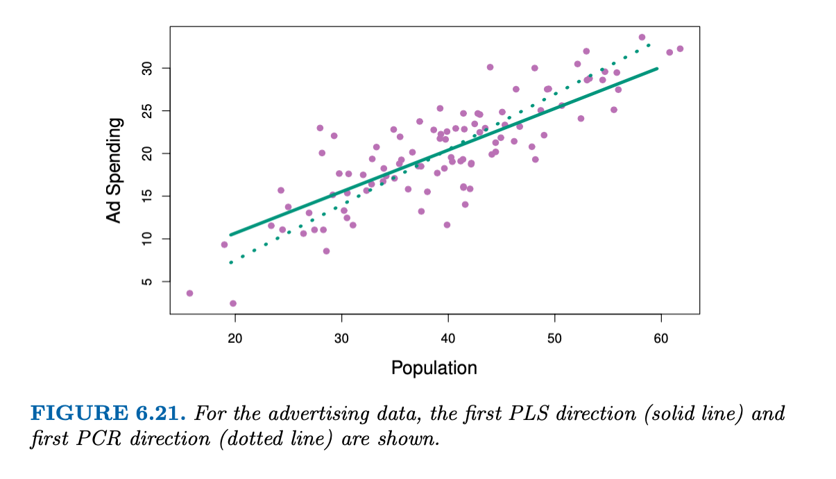
Partial least squares: Supervised Learning

Slide 35
Partial least squares
However, in practice, PLS often performs no better than ridge regression or principal component regression (PCR).
While the supervised dimension reduction of PLS can reduce bias, it also has the potential to increase variance.
So, it is often better to simply use PCR.

